Slide 1




University Institute of Engineering
Department of Computer Science & Engineering
COMPUTER ORGANIZATION & ARCHITECTURE
(23CST-204/23ITT-204)
ER. SHIKHA ATWAL
E11186
ASSISTANT PROFESSOR
BE-CSE

Slide 2
ASSEMBLY LANGUAGE INSTRUCTIONS
Program Execution in the CPU
It contains a special register — the instruction register — whose bit pattern determines what the central processor unit can do. Once that action has been completed, the bit pattern within the instruction register may be modified, and also the central processor unit can perform the operation nominative by this next bit pattern.
Since directions are simply bit patterns, they will be kept in memory. The instruction pointer register continuously has the memory address of (points to) the next instruction to be executed. So as for the management unit to execute this instruction, it’s derived into the instruction register.

Slide 3
The case is as follows:
A sequence of instructions is stored in memory.
The memory address wherever the first instruction is found is copied to the instruction pointer.
The CPU sends the address within the instruction pointer to memory on the address
bus.
The CPU sends a “read” signal to the control bus.
Memory responds by sending a copy of the state of the bits at that memory location on the data bus, that the CPU then copies into its instruction register.
The instruction pointer is automatically incremented to contain the address of the next instruction in memory.
The CPU executes the instruction within the instruction register.
Go to step 3

Slide 4
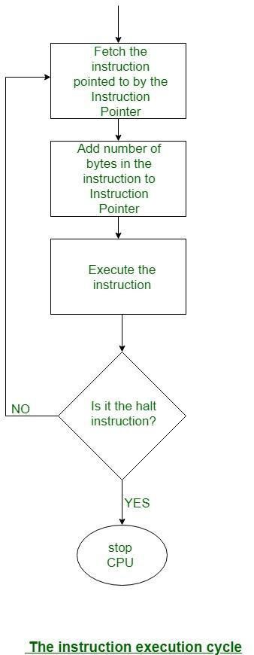
Steps 3, 4, and 5 are called an instruction fetch. Notice that steps 3 – 8 constitute a cycle, the instruction execution cycle. It is shown graphically below:

Slide 5
Instruction cycle
The time a microprocessor needs to fetch and execute one entire instruction is known as an instruction cycle.
There are typically four stages of an instruction cycle that the CPU carries out-
i. Fetching the instruction: The next instruction is fetched from the memory address that is currently stored in the program counter (PC) and stored in the instruction register (IR). At the end of the fetch operation, the PC points to the next instruction that will be read at the next cycle.

Slide 6
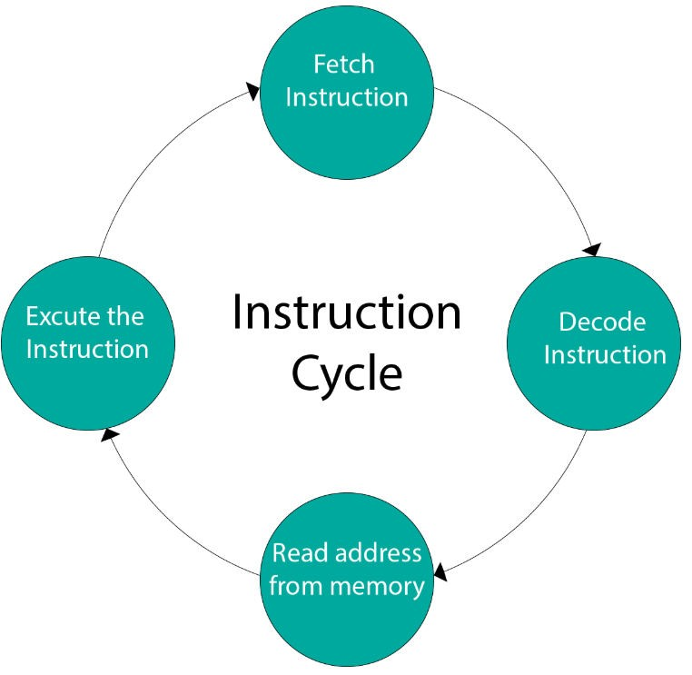

Slide 7
ii. Decode the instruction: During this cycle the encoded instruction present in the IR (instruction register) is interpreted by the decoder.
iii. Read the effective address: In case of a memory instruction (direct or indirect) the execution phase will be in the next clock pulse. If the instruction has an indirect address, the effective address is read from main memory and any required data is fetched from main memory to be processed and then placed into data registers (Clock Pulse: T3). If the instruction is direct, nothing is done at this clock pulse. If this is an I/O instruction or a Register instruction, the operation is performed (executed) at clock Pulse.

Slide 8
iv. Execute the instruction: The control unit of the CPU passes the decoded information as a sequence of control signals to the relevant function units of the CPU to perform the actions required by the instruction such as reading values from registers, passing them to the ALU to perform mathematical or logic functions on them and writing the result back to a register.
If the ALU is involved, it sends a condition signal back to the CU. The result generated by the operation is stored in the main memory or sent to an output device. Based on the condition of any feedback from the ALU, Program Counter may be updated to a different address from which the next instruction will be fetched.

Slide 9
Instruction Cycle State Diagram
For an instruction cycle, various states can be null, while others can be visited more than once. The below figure provides a large aspect of the instruction cycle of a basic computer.
Instruction Address Calculation − The address of the next instruction is computed. A permanent number is inserted to the address of the earlier instruction.
Instruction Fetch − The instruction is read from its specific memory location to the processor.

Slide 10
Instruction Operation Decoding − The instruction is interpreted and the type of operation to be implemented and the operand(s) to be used are decided.
Operand Address Calculation − The address of the operand is evaluated if it has a reference to an operand in memory or is applicable through the Input/Output.
Operand Fetch − The operand is read from the memory or the I/O.
Data Operation − The actual operation that the instruction contains is executed.
Store Operands − It can store the result acquired in the memory or transfer it to the I/O.

Slide 11
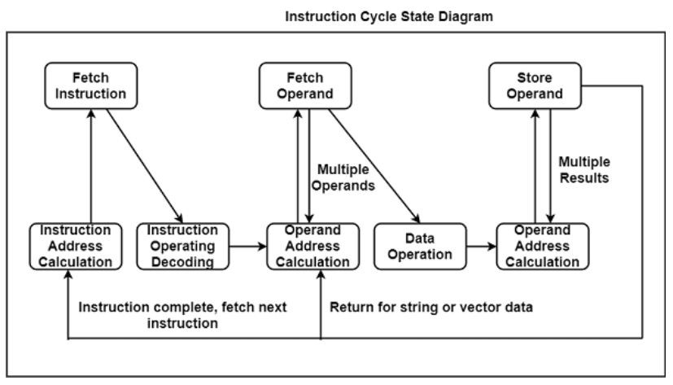

Slide 12
Machine Instructions are commands or programs written in machine code of a machine (computer) that it can recognize and execute.
A machine instruction consists of several bytes in memory that tells the processor to perform one machine operation.
The processor looks at machine instructions in main memory one after another, and performs one machine operation for each machine instruction.
The collection of machine instructions in main memory is called a machine language program.
Machine code or machine language is a set of instructions executed directly by a computer’s central processing unit (CPU). Each instruction performs a very specific task, such as a load, a jump, or an ALU operation on a unit of data in a CPU register or memory. Every program directly executed by a CPU is made up of a series of such instructions.

Slide 13
The general format of a machine instruction is
[Label:] Mnemonic [Operand, Operand] [;comments]
Brackets indicate that a field is optional.
Mnemonic is the symbol for instruction operation code.
Label is an identifier that is assigned the address of the first byte of the instruction in which it appears. It must be followed by “:”
Inclusion of spaces is arbitrary, except that at least one space must be inserted. No space would lead to an ambiguity.
Comment field begins with a semicolon (;).
Example: Here: MOV R5, #25H ;load 25H into Register R5

Slide 14
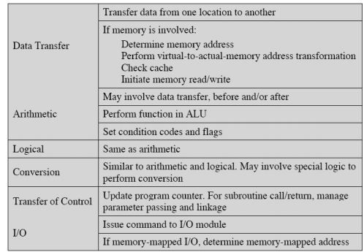
What happens during Instruction Execution?

Slide 15
MACHINE CYCLE: The machine cycle is the number of cycles needed to do either a fetch, read or write operation. The read or write may be more than a single bus cycle if the transaction between the CPU and memory is longer than the data width fetched or written.
BUS CYCLE: The bus cycle is the cycle or time required to make a single read or write transaction between the CPU and an external device such as external memory.
For example, on an 8085 machine, the data bus width is 8 bits. If the CPU needs to fetch or write 16 bits of data, that will require two bus cycles and one machine cycle as it will use a 16- bit register directly to fetch or write the data.

Slide 16
References
Reference Books:
J.P. Hayes, “Computer Architecture and Organization”, Third Edition.
Mano, M., “Computer System Architecture”, Third Edition, Prentice Hall.
Stallings, W., “Computer Organization and Architecture”, Eighth Edition, Pearson Education.
Text Books:
Carpinelli J.D,” Computer systems organization &Architecture”, Fourth Edition, Addison Wesley.
Patterson and Hennessy, “Computer Architecture” , Fifth Edition Morgaon Kauffman.

Slide 17
Reference Website
https://www.slideshare.net/shweta-sharma99/instruction-cycle
http://www.eie.polyu.edu.hk/~enyhchan/addrmode.pdf
http://www.cs.uwm.edu/classes/cs458/Lecture/HTML/ch05s05.html
Video References
https://www.youtube.com/watch?v=p9n91lXeJ8Y
https://www.youtube.com/watch?v=3MfyrwPjYk4

